Slide 1
AKHUWAT CLOTHES BANK Abubakr Siddique 25th Nov, 2018

Slide 2
INTRODUCTION
Akhuwat Clothes Bank is an extension of Akhuwat Micro-finance, and applies the same model and philosophy.
Akhuwat Clothes Bank was established in February 2014.
Clothes collected from affluent families are repaired, washed/dry-cleaned and packed.
The packed clothes are then distributed in the underprivileged communities with due respect and honor

Slide 3
VISION
“Working towards a decently dressed Pakistan”
MISSION
We aim to provide decent clothing as a gift with love, care and dignity to those who are socially, financially marginalized.
Our slogan is
“No Pakistani deserves to be without appropriate clothes.”

Slide 4
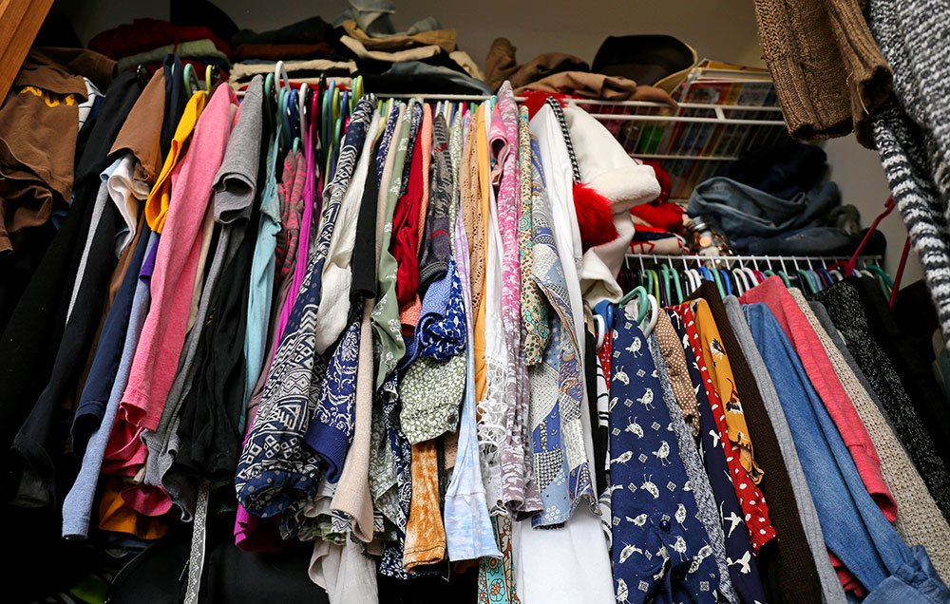
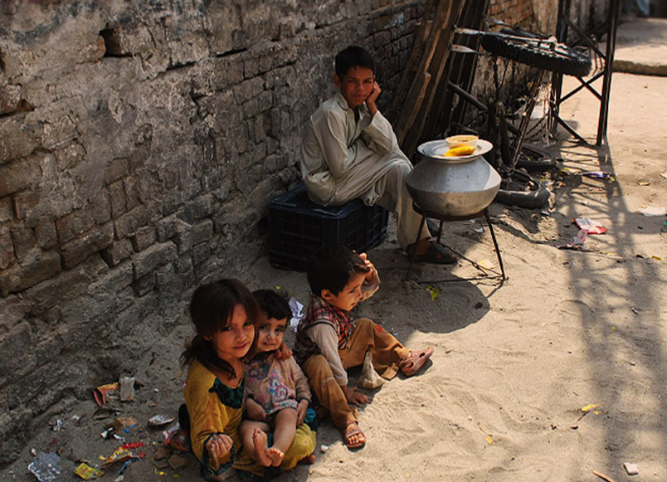
REDUCE & RE-USE
PROBLEM
Excessive Clothes
Poverty
Fast Fashion / Quick Cycle
Discarded Clothes- Landfill
Landfill = Environmental damage
Low-income
In-kind donation = saving
Saving = poverty alleviation

Slide 5
REDUCE & RE-USE
SOLUTION
Excessive Clothes
Poverty
Reduce wearables
Re-use and Recycle

Slide 6
REDUCE & RE-USE
SOLUTION
Waste
Poverty

Slide 7
MODEL
Usable clothes are collected from affluent people
ENGAGING TRANSGENDER COMMUNITY
Clothes collected are:
- Sorted
- Washed/Dry-cleaned
- Repaired/Stitched
- Ironed
- Packed
Packed clothed are distributed to the underprivileged communities with due honor and respect

Slide 8
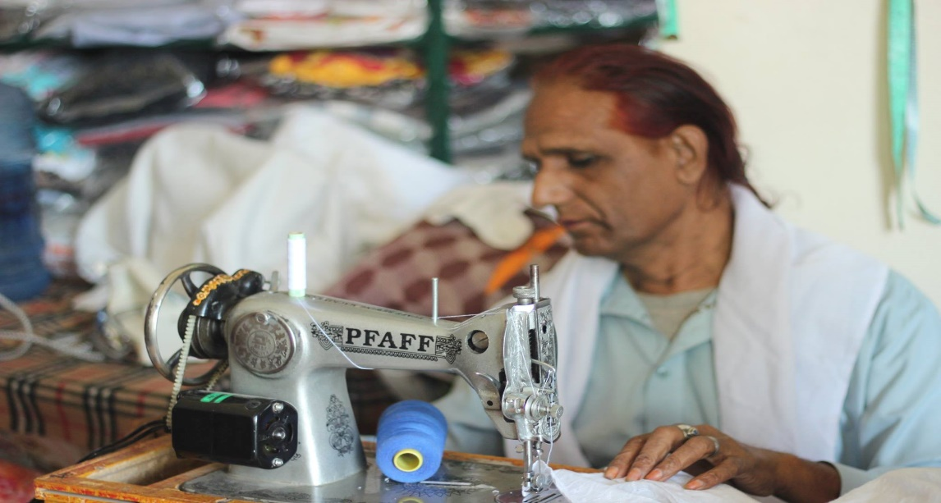
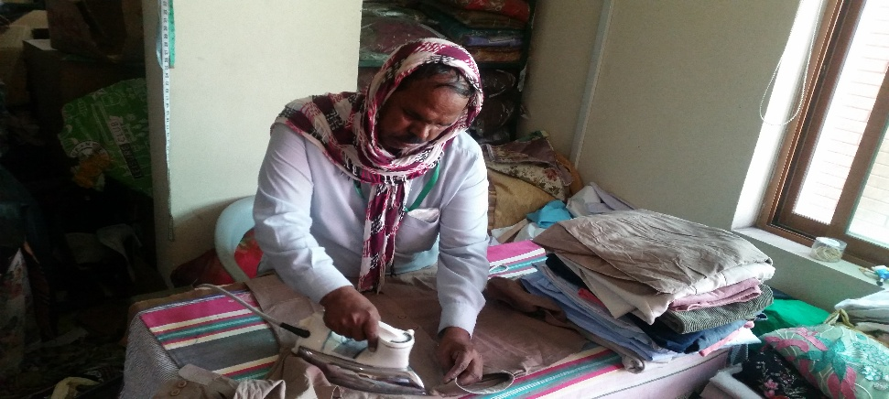
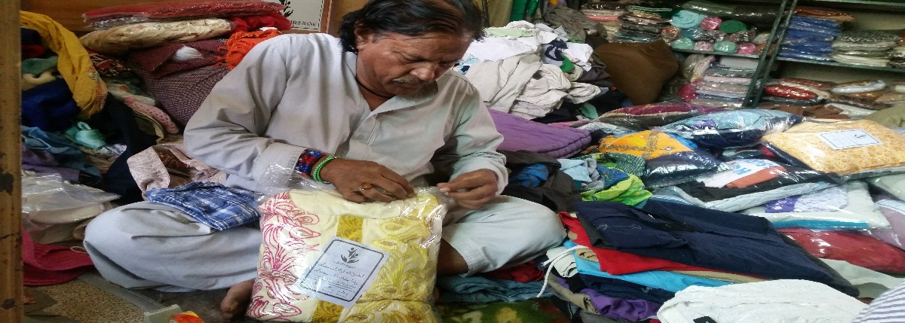
OPERATIONS OF CLOTHES BANK
Sorting
Stitching
Ironing
Packing

Slide 9
REDUCE & RE-USE
RECEIVABLES
Kitchen utensils
Clothing
Educational resources
Misc. furniture
Sports equipment

Slide 10
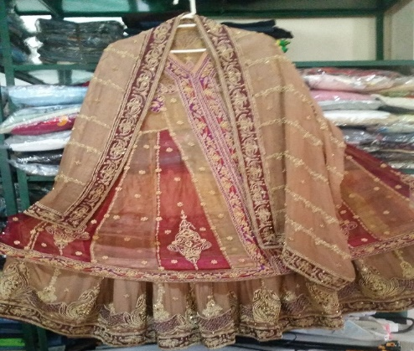
WEDDING GIFT
An another way to facilitate the needy and underprivileged people of Pakistan.
A wedding gift is presented to the girl whose family is not able to afford the clothes and other items for the wedding.
Akhuwat Clothes Bank gifts fancy clothes, shoes , bag , comforter and other items depending on the donation received.

Slide 11
PROJECT PROGRESS
Total Collection: 2,104,223 clothes
Total Disbursement: 1,980,701 clothes
Approximate Value: 2,104,223 * 1000 = Rs. 2,104, 223, 000/- (USD $20 Million)

Slide 12
SOURCE OF COLLECTION
NATIONALLY
Students of schools and universities
Philanthropists
INTERNATIONALLY – we receive from all around the globe
USA
UK
Middle East
Europe
Australia

Slide 14
ITEMS COLLECTED

Slide 15
AGE GROUPS CATERED
0-5
5-18
18-45
18-65
46 – 100
46 – 100

Slide 16
DISBURSEMENT
Disburse clothes among the needy and underprivileged people, all over Pakistan.
Tharparkar to Gilgat Baltistan.
Tap poorest of the poor people.
White Collar Individuals.
Collaborations with local ngo’s as well as International ngo’s.

Slide 17
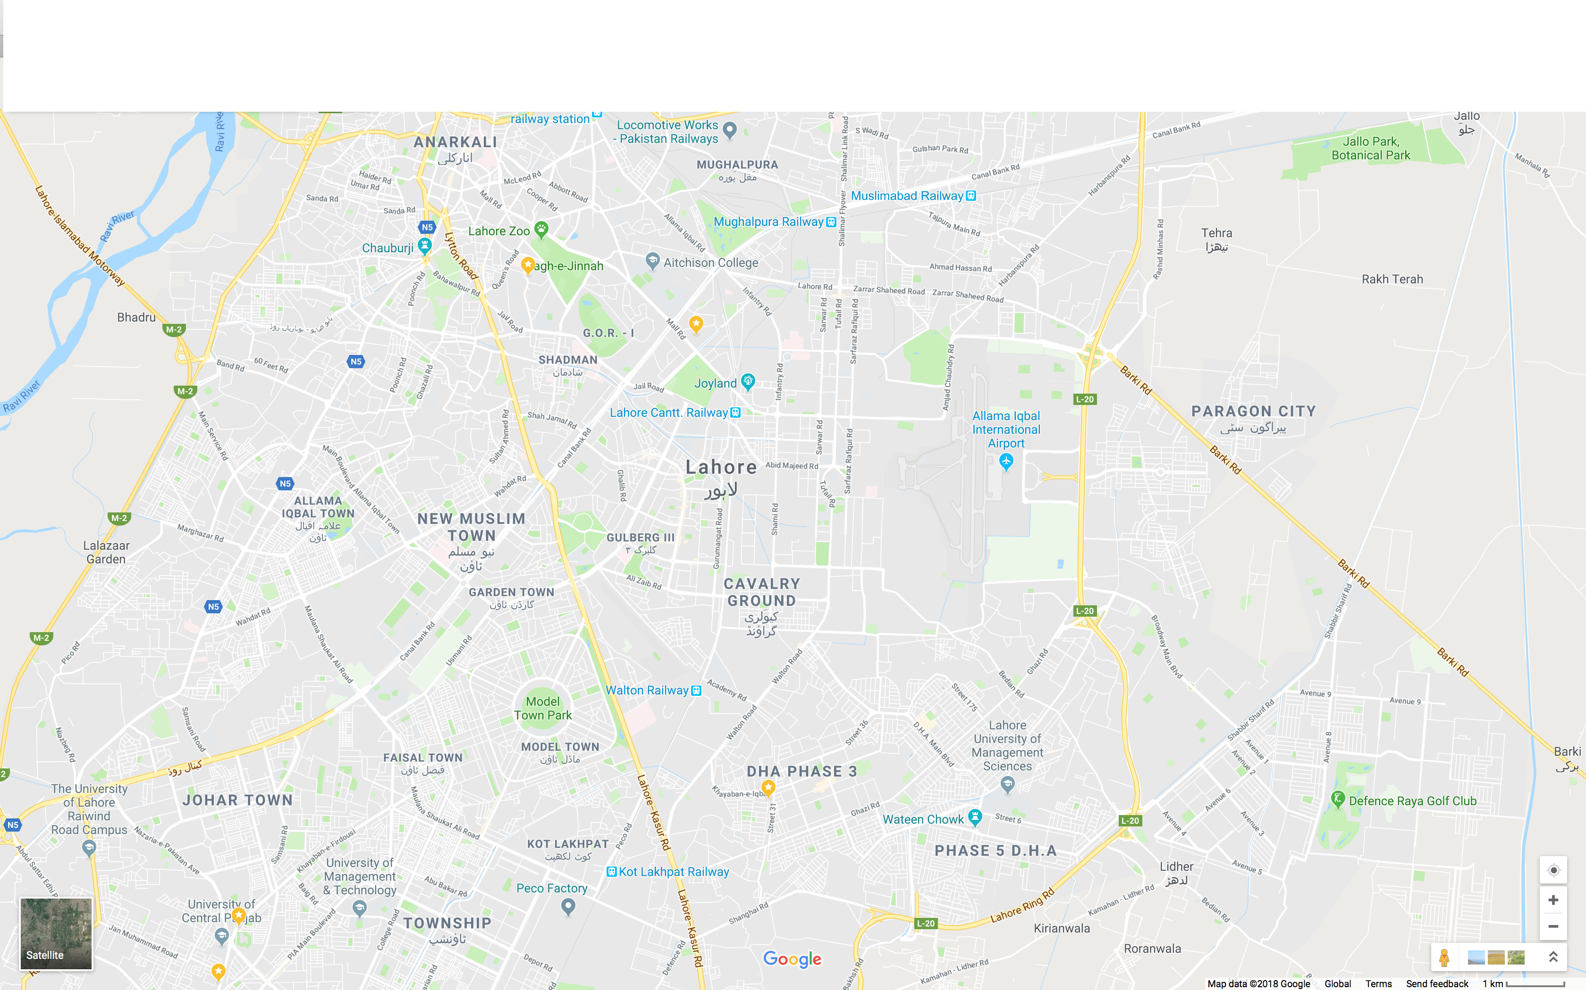
COLLECTION METHOD
Collection Point
Pickup trucks
Clothes Bank

Slide 18
SHARING MOMENTS

Slide 19
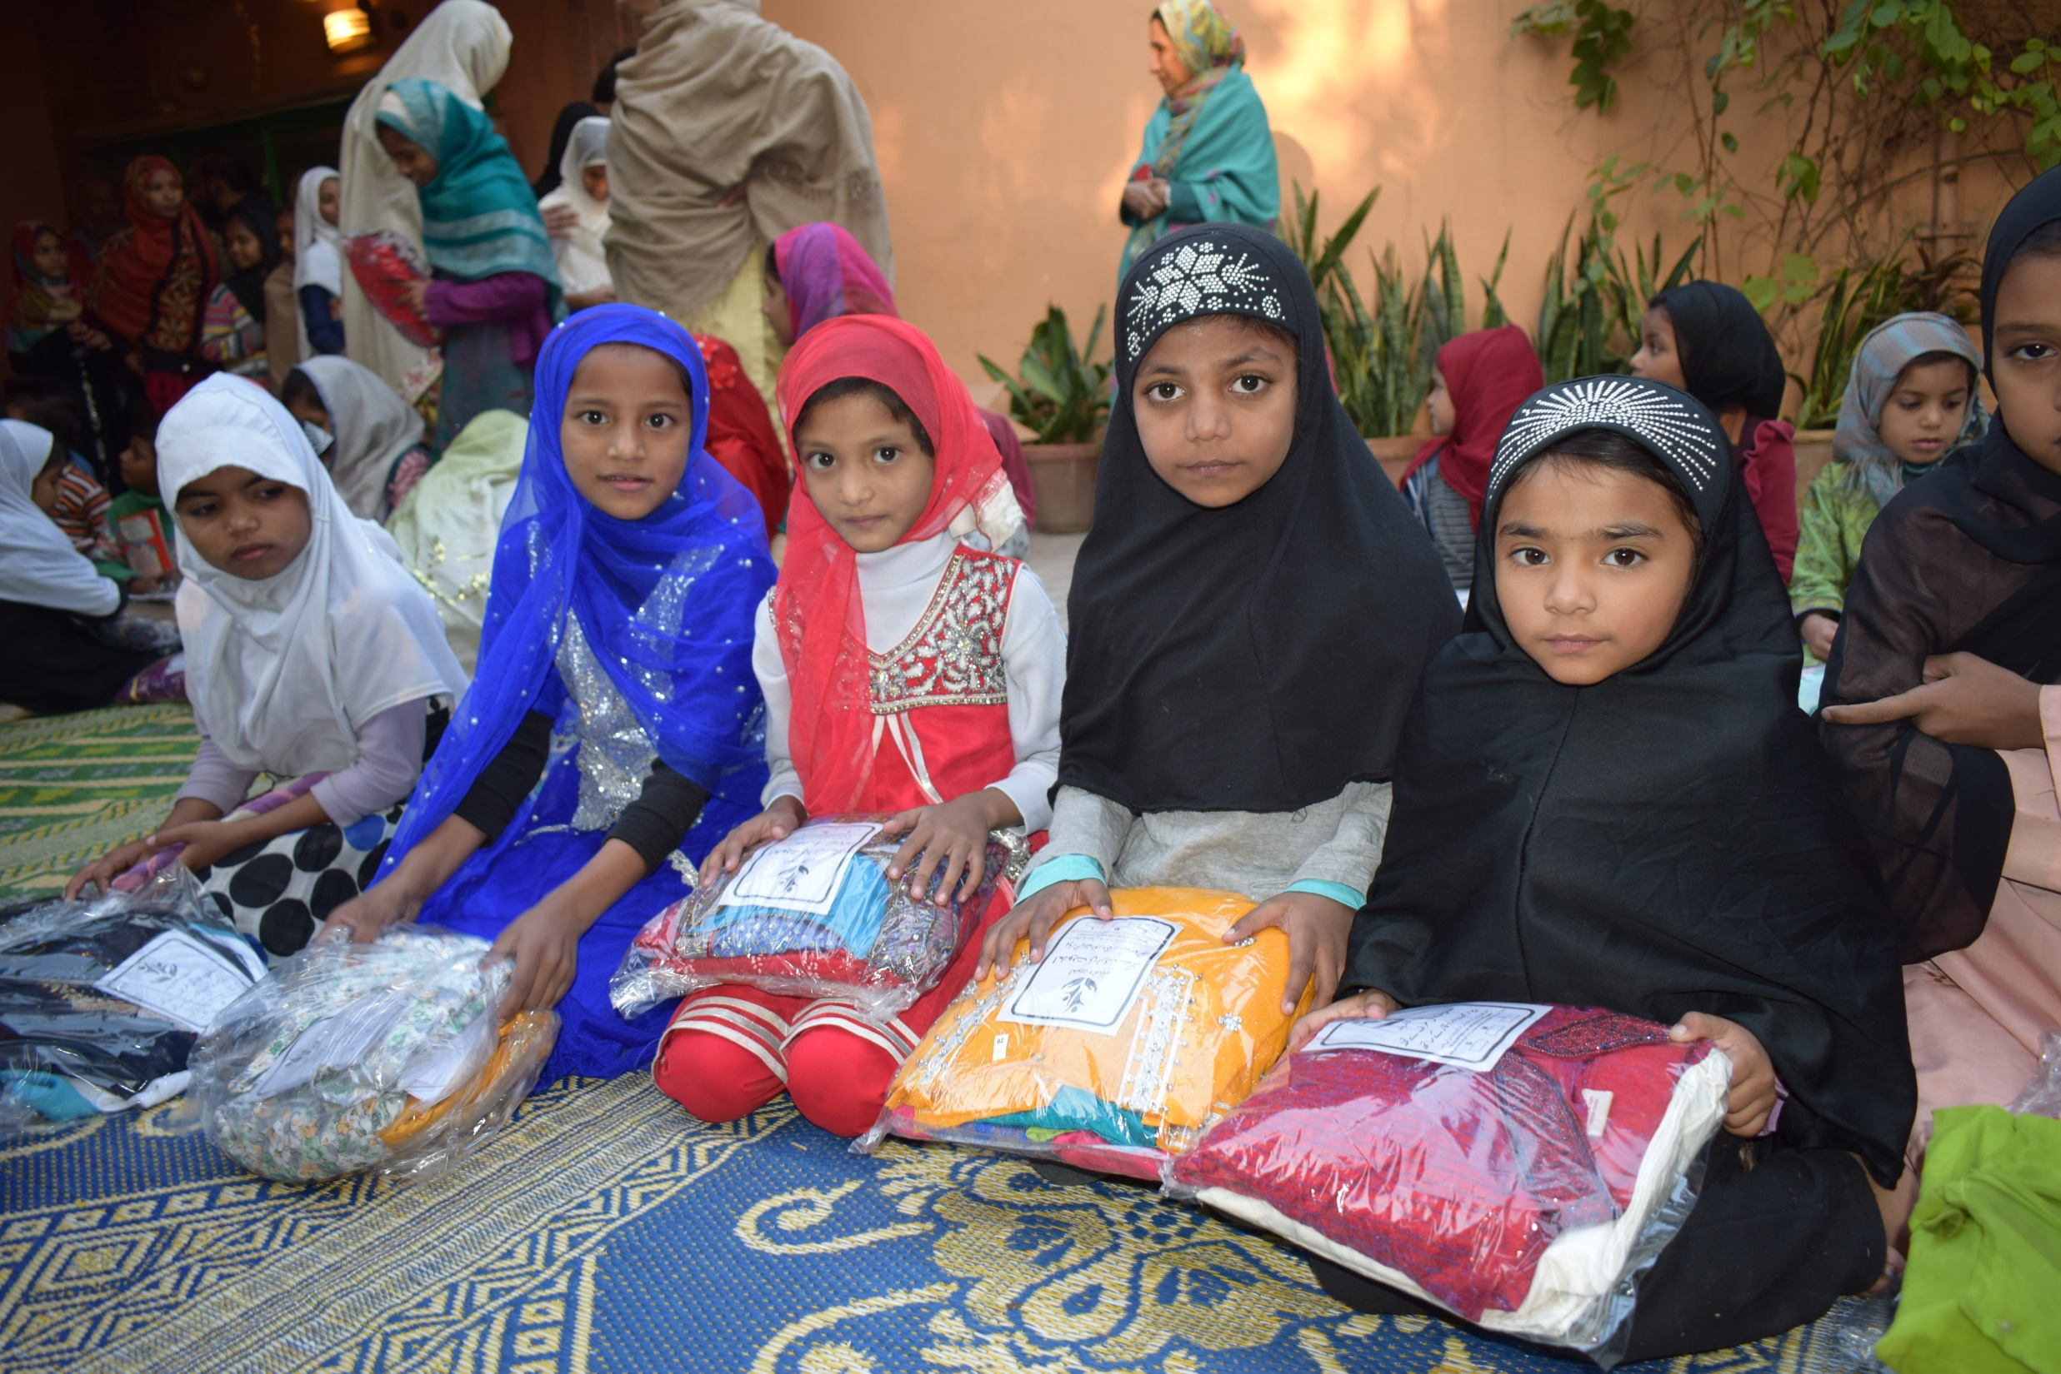
Moutian primary school, Lahore

Slide 20
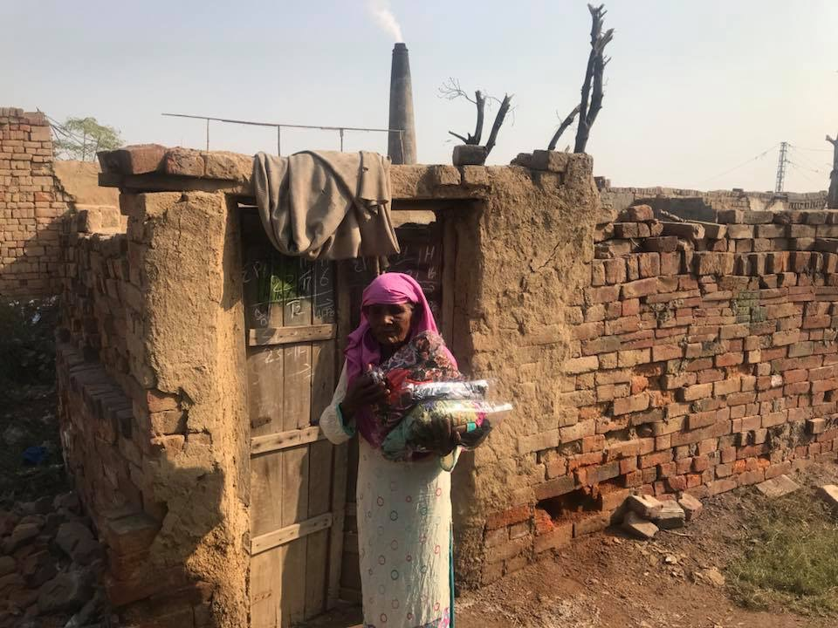

Slide 21
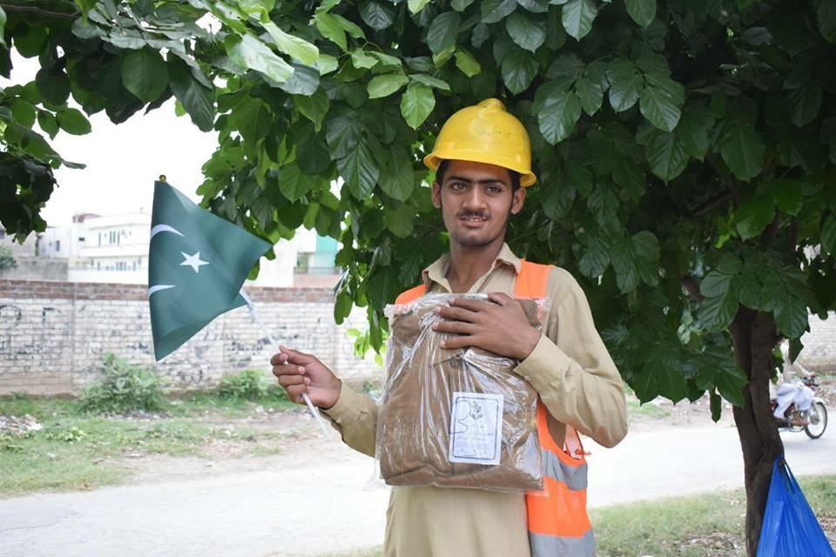

Slide 22
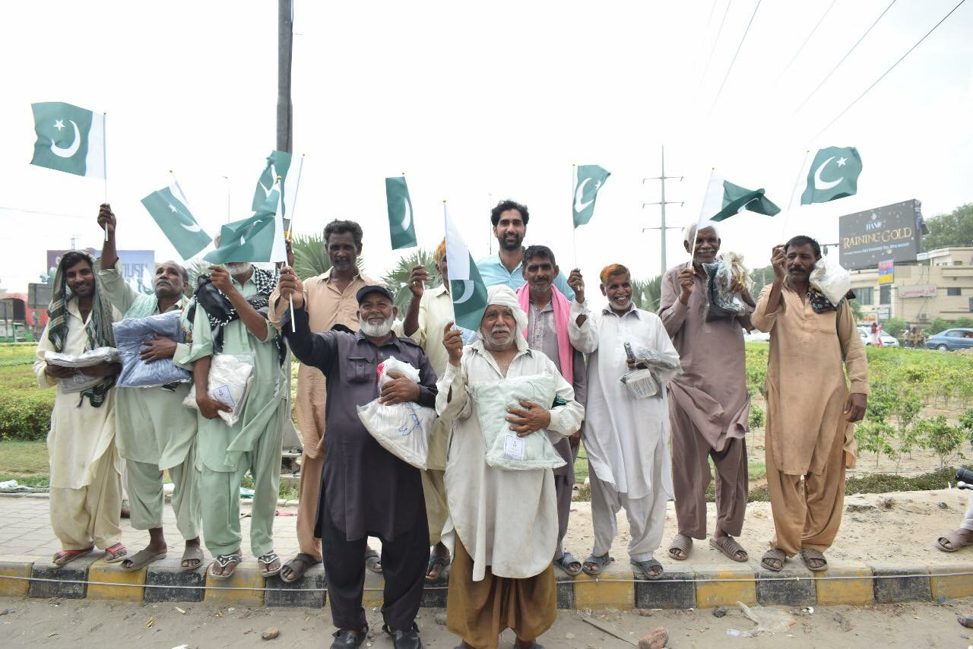

Slide 23
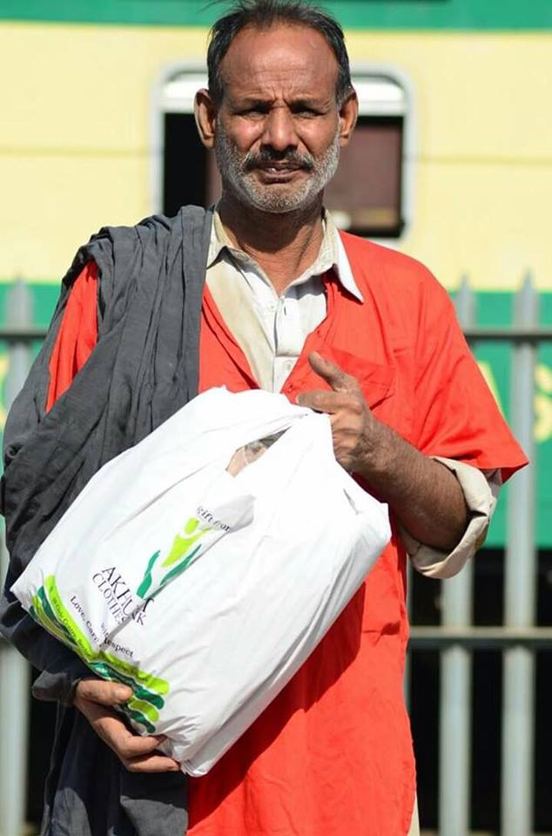
Rawalpindi Railway Station

Slide 24
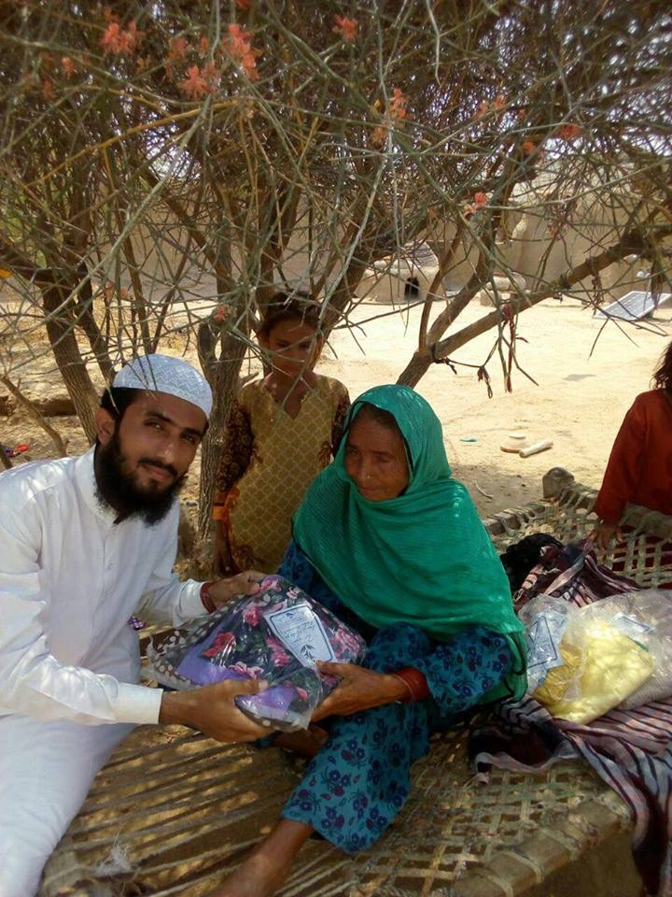
Tunsa Sharif, D.G Khan

Slide 25
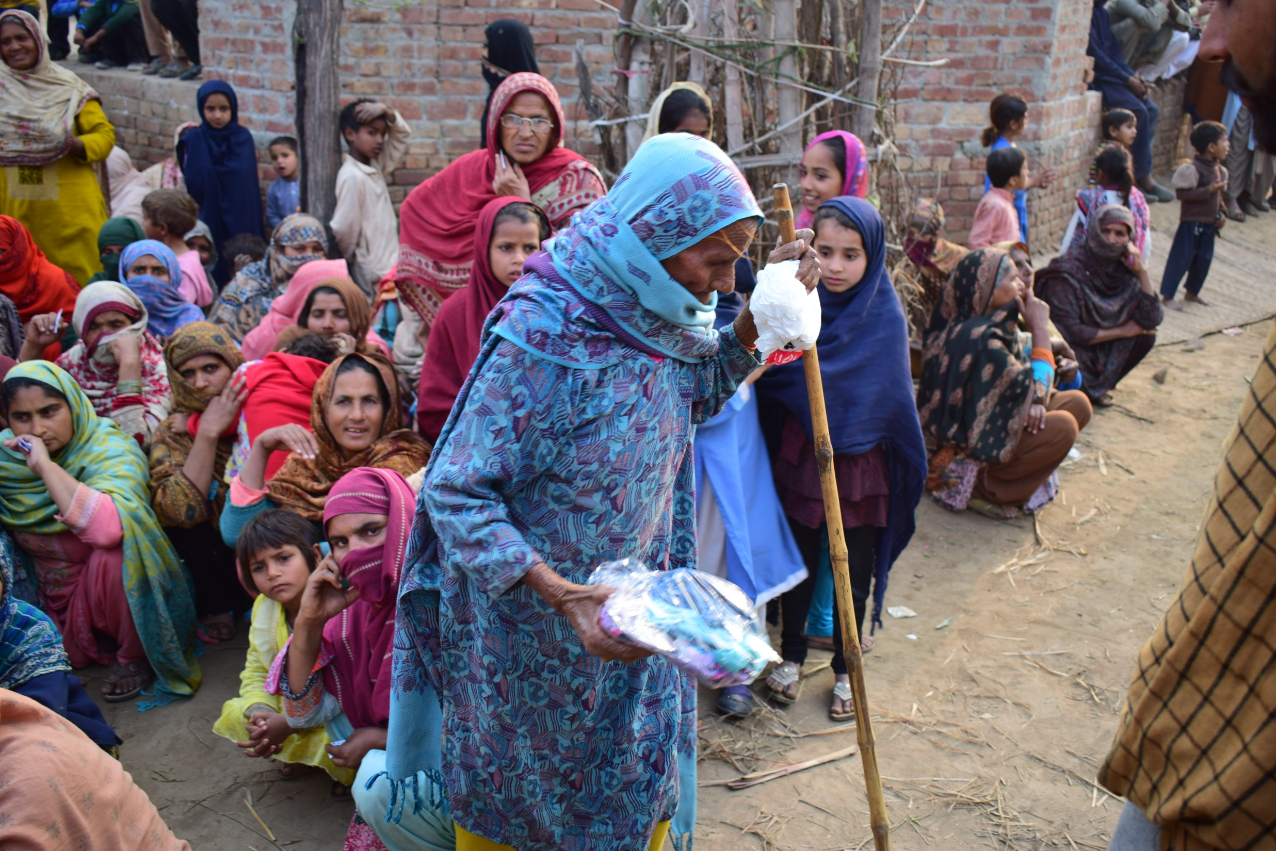
Taluka Village, Jangh

Slide 26
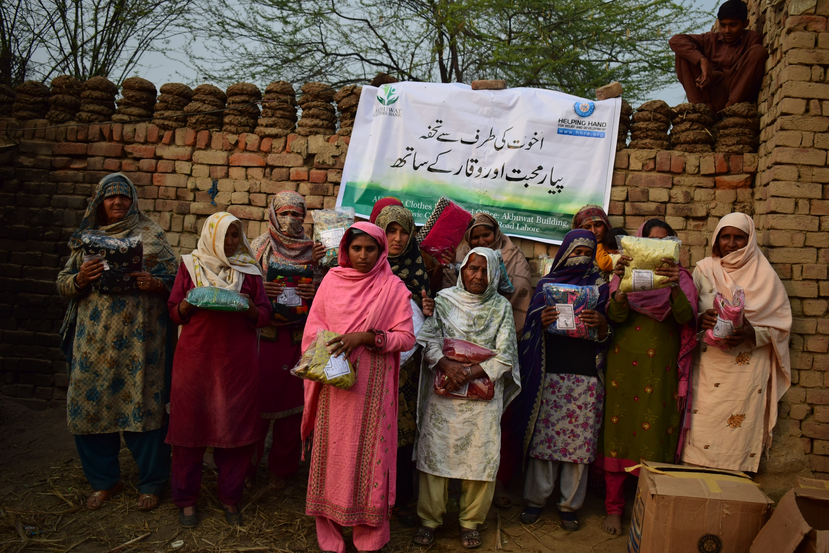
Riawind, Lahore

Slide 27
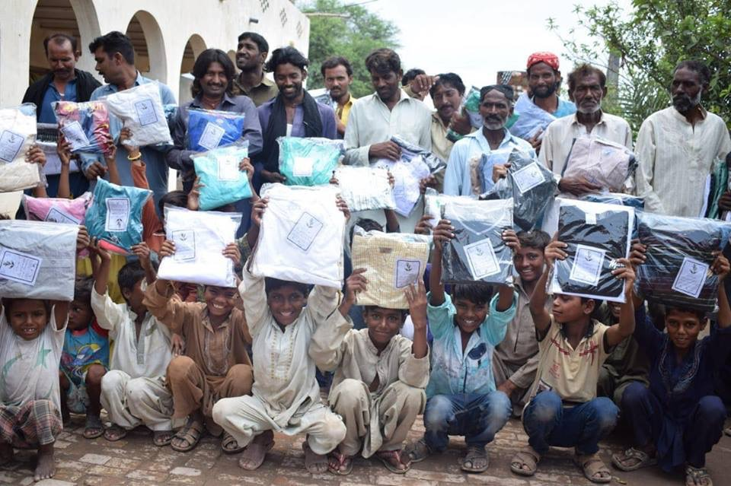

Slide 28
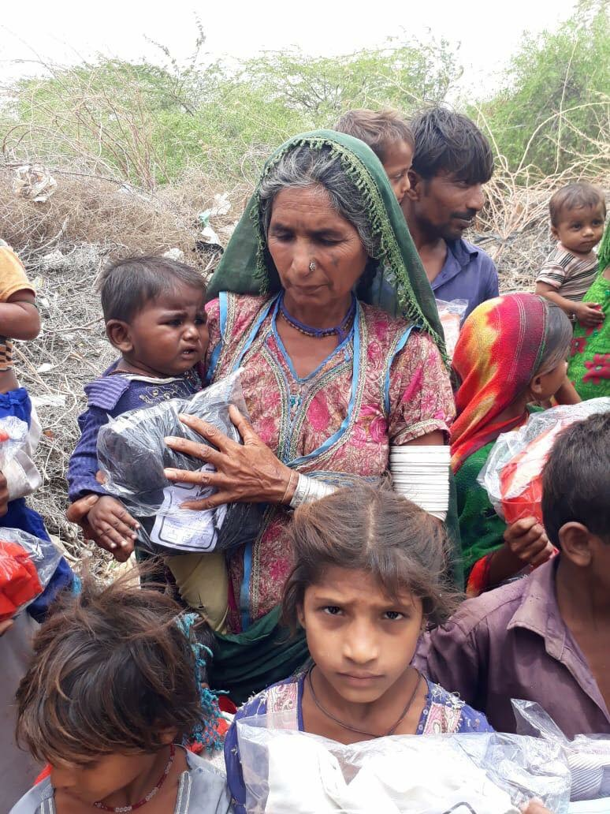

Slide 29
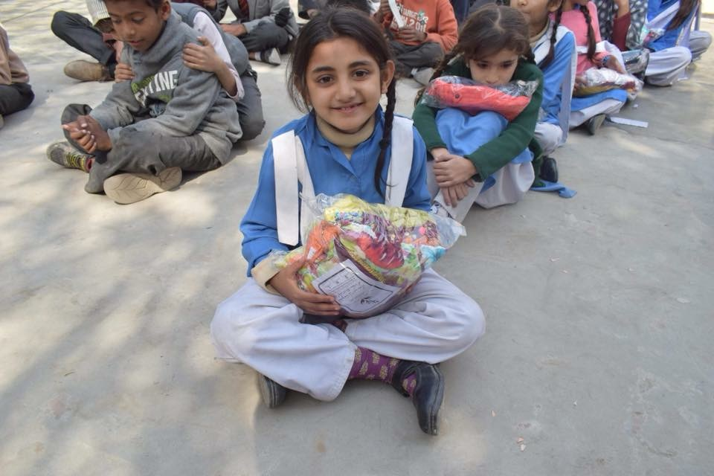

Slide 30
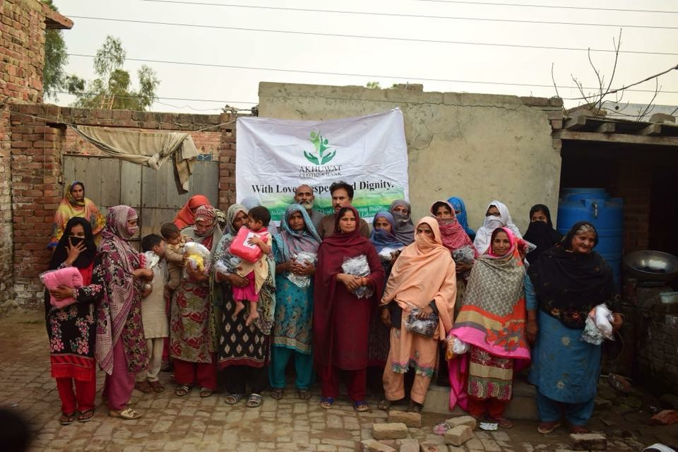

Slide 31
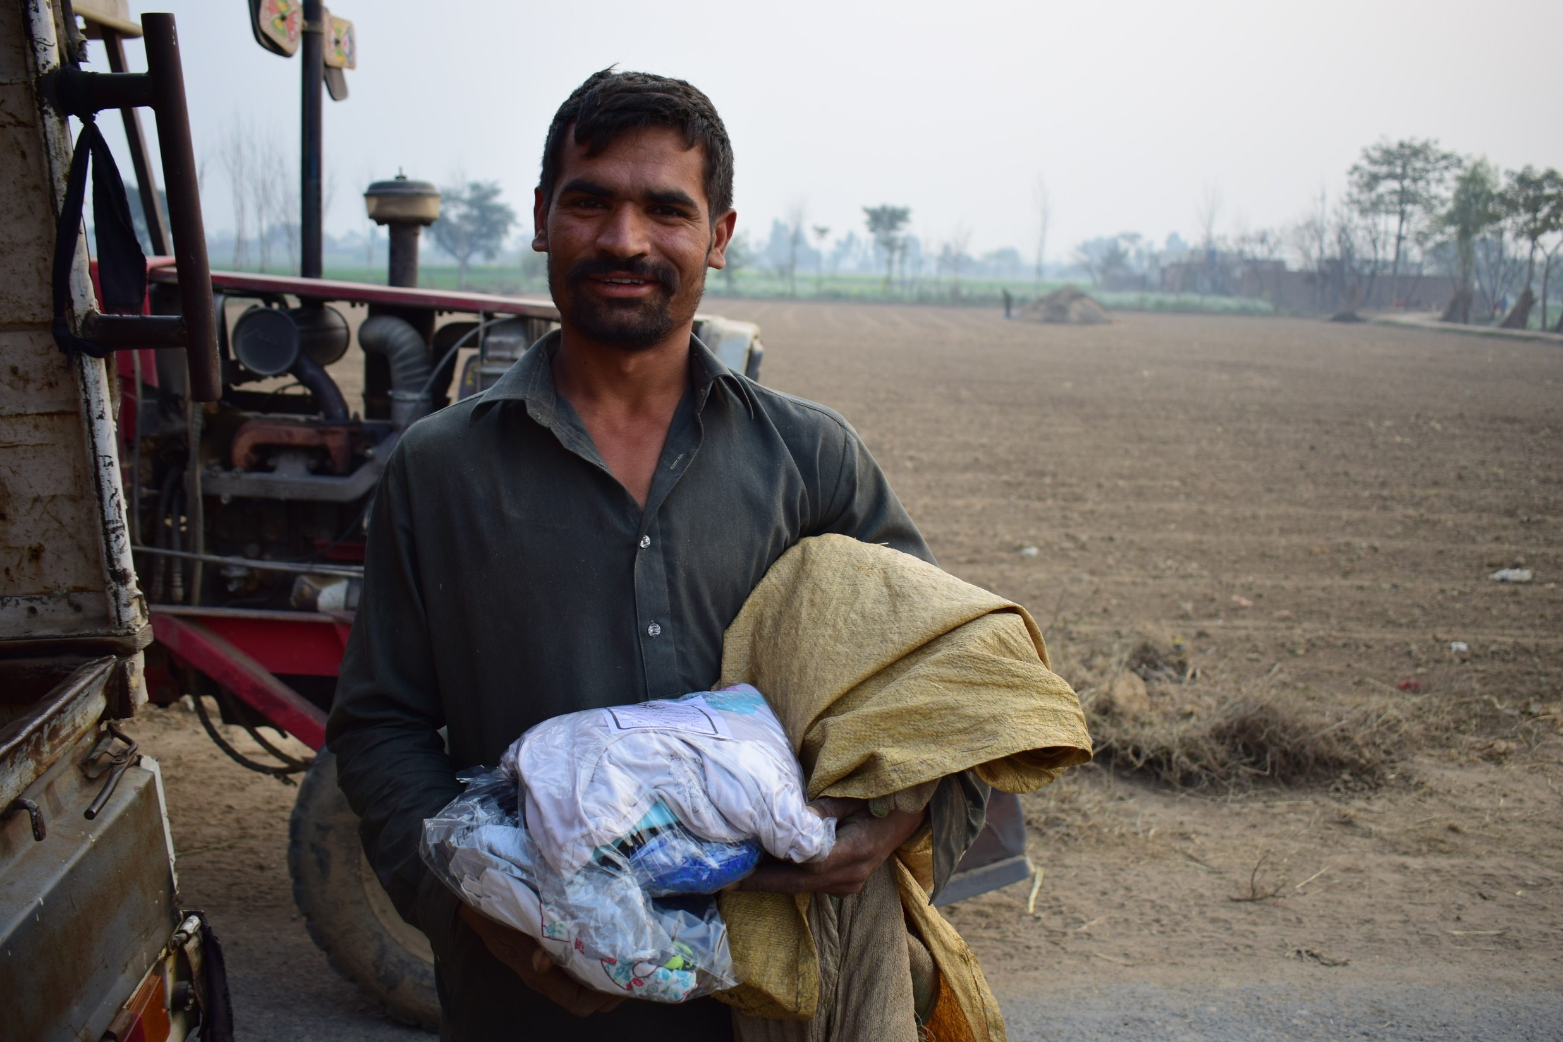
Bahi pharoo, Kasure

Slide 32
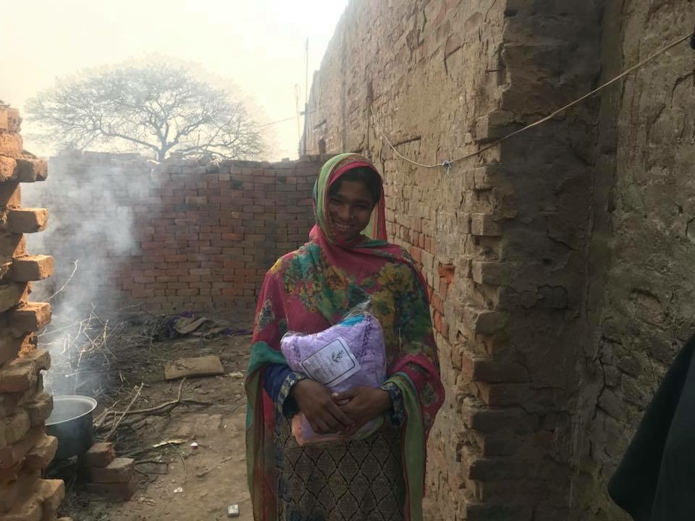

Slide 33
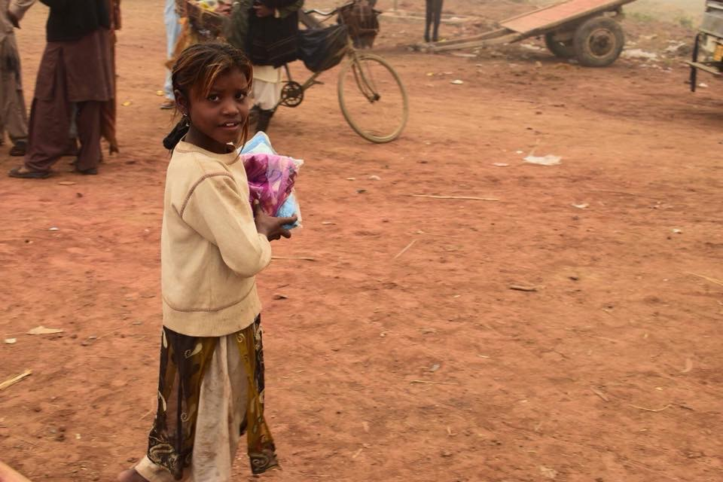

Slide 34
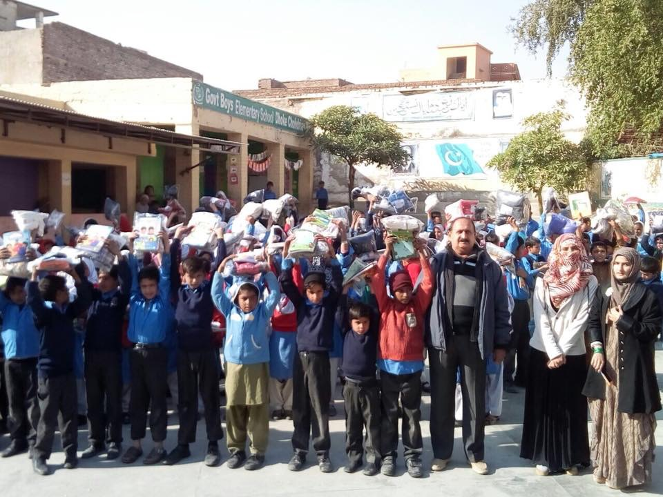

Slide 35
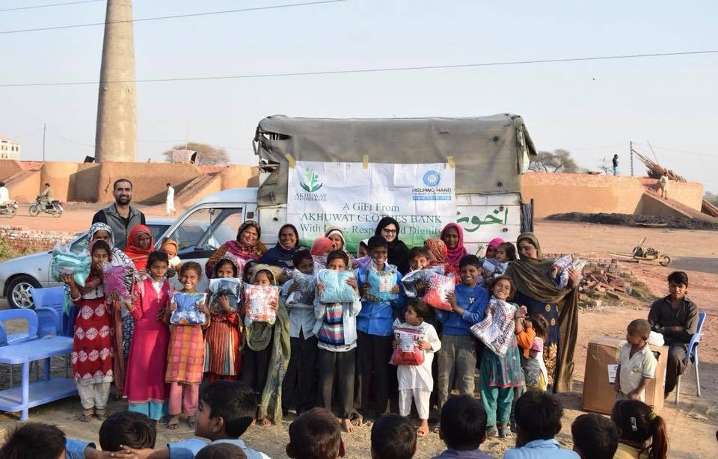

Slide 36
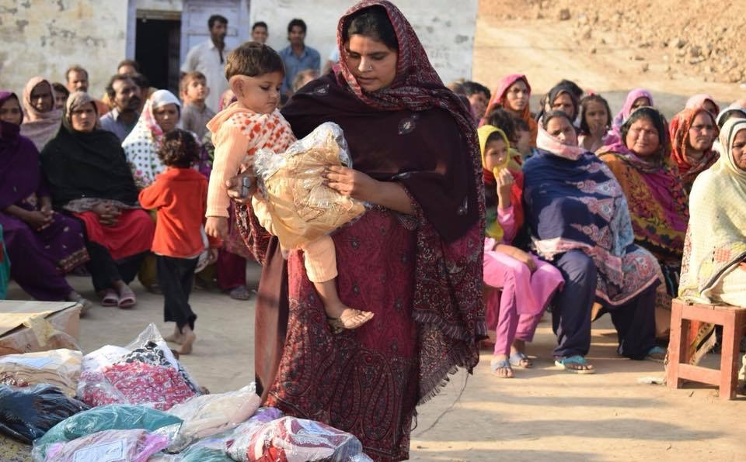

Slide 37
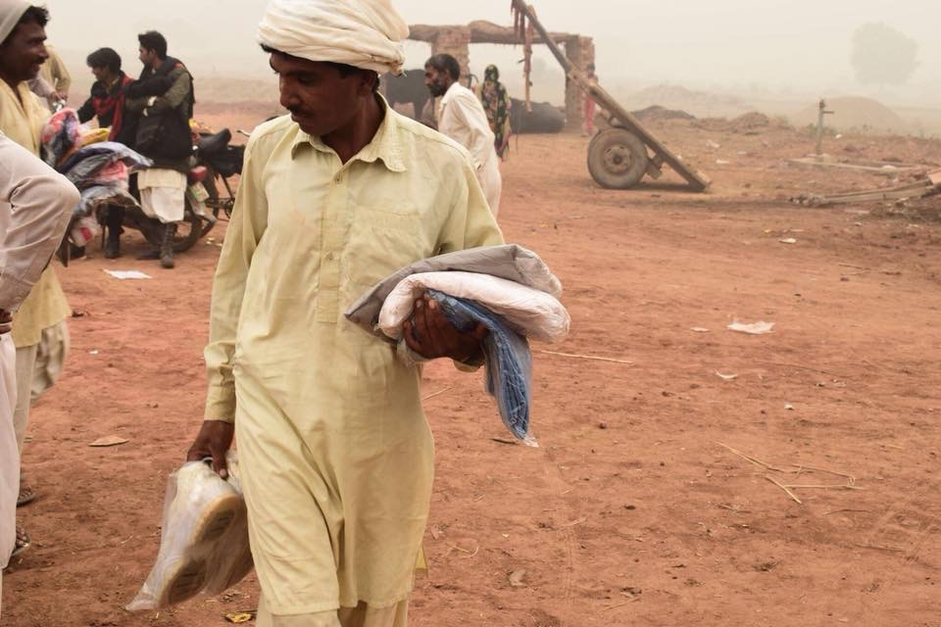

Slide 38
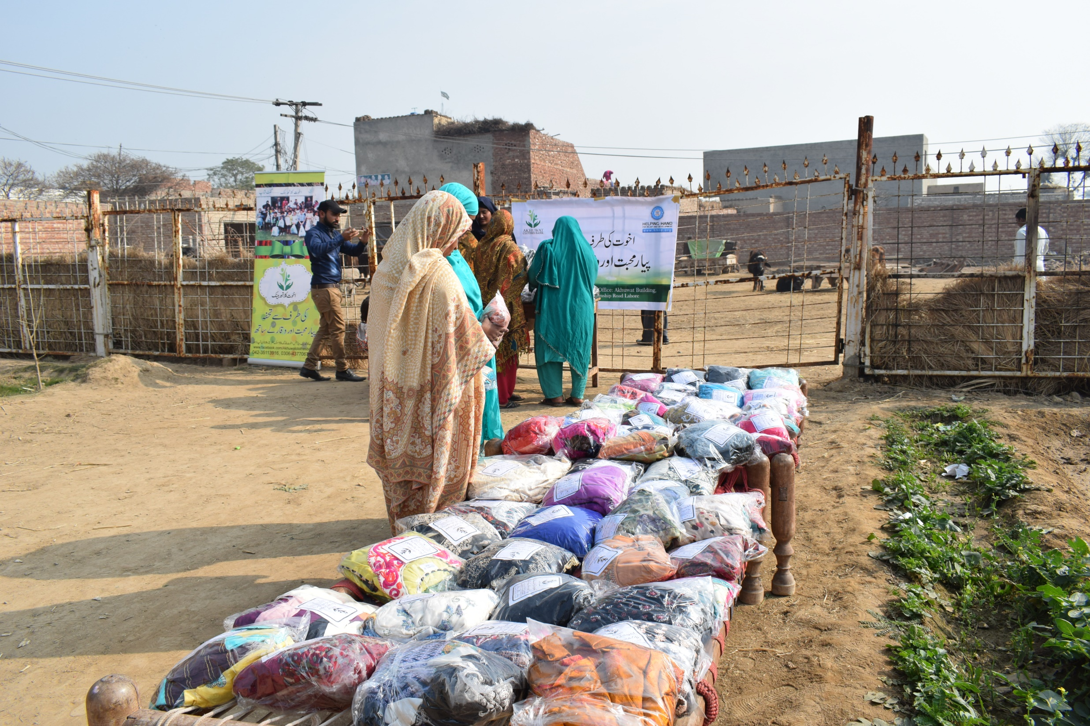

Slide 39
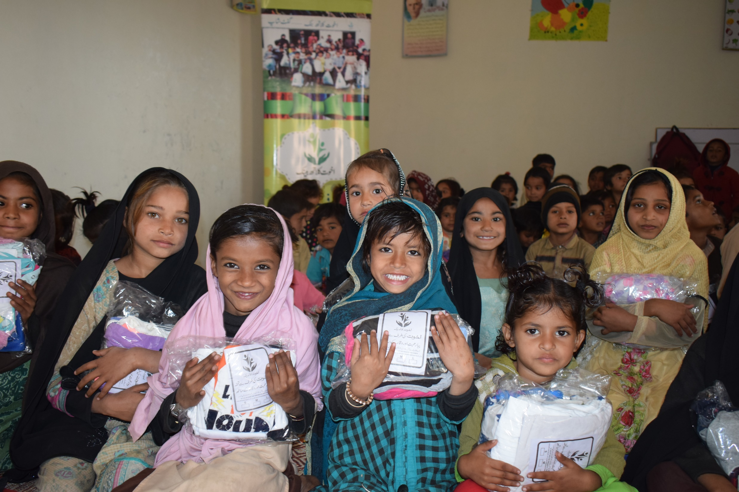

Slide 40
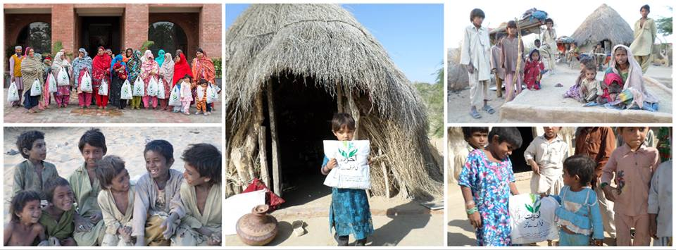
MITHI , SINDH

Slide 41
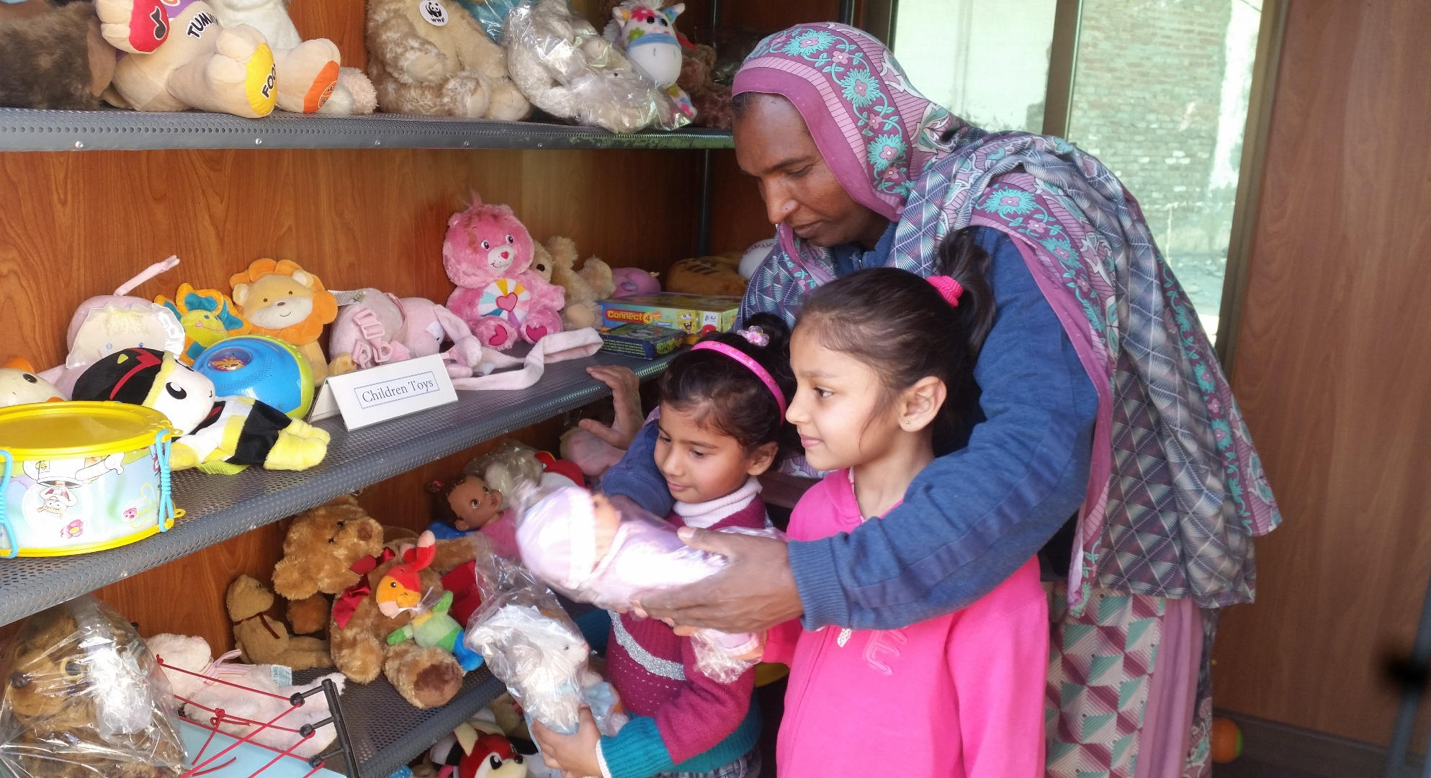
SHOPPING EXPERIENCE

Slide 42
THANK YOU

